Slide 1
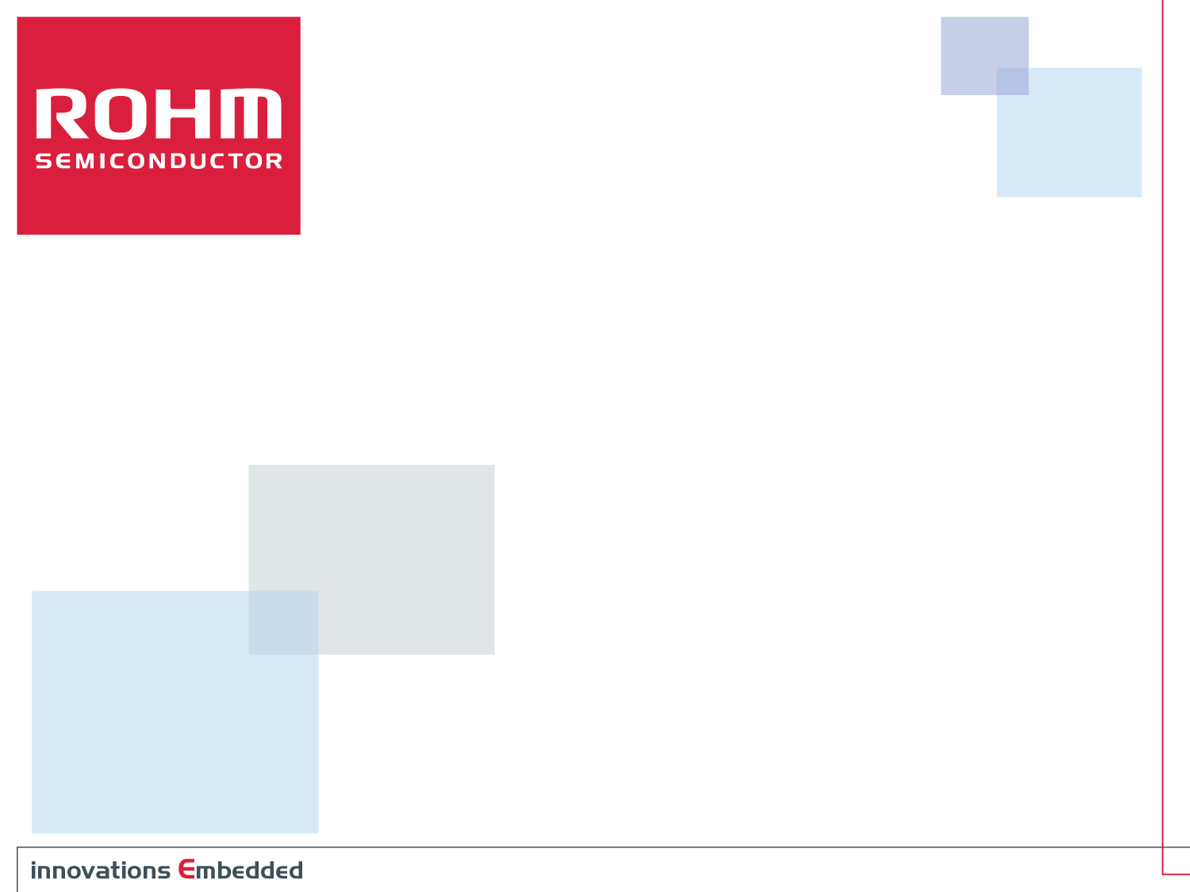
ROHM Multi-Sensor Shield Evaluation Board
For use with ROHM Sensor Platform Kit
Specification
ROHM Semiconductor USA, LLC

Slide 2
General Requirements
Overview
  The Sensor platform board is now built and available; however, there are aspects that we can improve.
  One major point we would like to address is the ability to use multiple sensors at once. This can be used as a general evaluation board of ROHM’s portfolio of sensors as well as a development environment for sensor fusion based applications
Target Audience
  Customers looking to evaluate ROHM’s sensor portfolio
  Customers/Engineers Looking to develop sensor fusion algorithms with multiple sensor products
Sensors to Cover
  Hall IC
  Ambient Light Sensor/Proximity all-in-one combo IC
  RGB Color Sensor
  UV Sensor
  MEMS Sensors – Accel, Accel+Mag, Gyro
  Temperature Sensor
  Pressure Sensor
ROHM Semiconductor USA, LLC

Slide 3
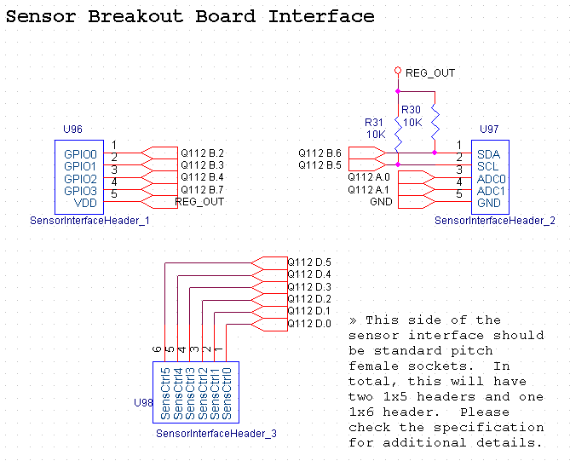
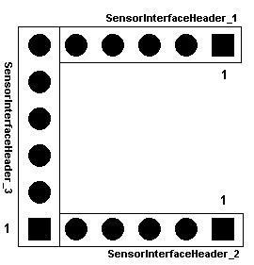
Schematic Details – Sensor Interface
*Please confirm pin 1 placements against sensor platform base board we made with you previously
ROHM Semiconductor USA, LLC

Slide 4
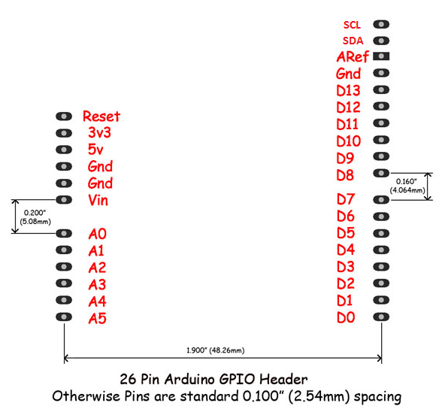
Schematic Details – Arduino Headers
H7 – Header_Ard_Digital2
H4 – Header_Ard_Power
H6 – Header_Ard_Digital1
H5 – Header_Ard_AnalogIn
ROHM Semiconductor USA, LLC

Slide 5
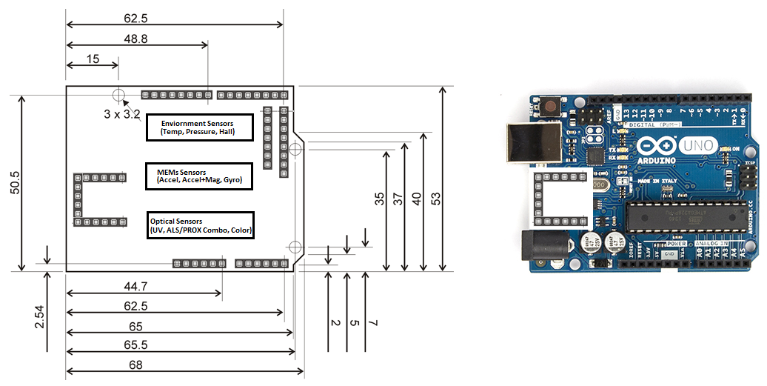
High Level Layout – MultiSensor Breakout Board
Above is just general placement of the headers (Feel free to adjust as required)
Only major point to have the MEMs sensors as close to the center of the board as possible
ROHM Semiconductor USA, LLC

Slide 6
Included Sensors
ROHM Sensors
  UV Sensor (1 ADC)
    ML8511
  Accel + Mag (I2C)
    KMX61
  Temperature Sensor (1 ADC)
    BDE0600G
ROHM New Sensors
  Omnipolar Hall (2 GPIO)
    BU52014HFV
  ALS and Prox (I2C)
    RPR-0521
  Pressure (I2C)
    BM1383GLV
  Accel Only (I2C)
    KC122 (I2C)
  Color Sensor (I2C)
    BH1745NUC (I2C)
  Gyro (I2C)
    KXG03
Total Pins/Outputs from the board
  6, I2C based device
  2, ADC based device
  1, GPIO based device
ROHM Semiconductor USA, LLC

Slide 7
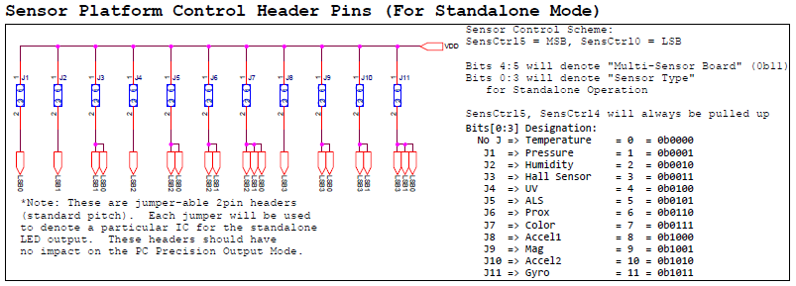
Operation Usage
Standalone Mode (No PC usage):
  Jumpers will be used to set the standalone mode output for the various sensors
High Precision Output Mode (UART Output to PC):
  This mode will be very similar to the single sensor mode as we can add lines to the output stream corresponding to each of the sensor outputs
ROHM Semiconductor USA, LLC

Slide 8
Requirements to Launch
Need to route Layout
Need to generate Application Note
Need to code new Base Board Firmware to include this as a new sensor
  Source available on Github
  This revision should not break the operation of the existing firmware
ROHM Semiconductor USA, LLC

Slide 9
Disclaimer
Some products in this document may have been replaced or may be under development. For the most current product information, contact a ROHM sales representative in your area: http://www.rohmsemiconductor.com/contact_us/contact_us.htm.
ROHM assumes no responsibility for the use of any circuits described herein, conveys no license under any patent or other right, and makes no representations that the circuits are free from patent infringement. Specifications subject to change without notice for the purpose of improvement.
The products listed in this document are designed to be used with ordinary electronic equipment or devices (such as audio visual equipment, office-automation equipment, communications devices, electrical appliances and electronic toys). Should you intend to use these products with equipment or devices which require an extremely high level of reliability and the malfunction of which would directly endanger human life (such as medical instruments, transportation equipment, aerospace machinery, nuclear-reactor controllers, fuel controllers and other safety devices), please be sure to consult with a ROHM sales representative in advance.
©2010 ROHM Semiconductor USA, LLC. Although every effort has been made to ensure accuracy, ROHM accepts no responsibility for errors or omissions. Specifications and product availability may be revised without notice. No part of this document represents an offer or contract. Industry part numbers, where specified, are given as an approximate comparative guide to circuit function only. Consult ROHM prior to use of components in safety, health or life-critical systems. All trademarks acknowledged.
ROHM Semiconductor USA, LLC

